Slide 1

Erlang/Elixir
Creating concurrent and parallel systems
Tayllan Búrigo

Slide 2

Summary
Erlang
OTP + BEAM
Elixir
Concurrency vs. Parallelism
  Concurrency models
Erlang processes
"Let it crash"
Hot Code Reloading

Slide 3
DISCLAIMER
Not an Elixir workshop!

Slide 4
Erlang
Concurrent, functional programming language
Focus to build massively scalable real-time systems with requirements on high availability
  Distributed
  Fault-tolerant
  Soft real-time (voice call https://stackoverflow.com/a/17309403/5953895)
  Highly available, non-stop applications (hot swapping code too)
Developed at Ericsson by Joe Armstrong in 1986

Slide 5
OTP (Open Telecom Platform)
It WAS about Telecom
Standard framework + libraries
  Compiler/interpreter
  Logger
  Mnesia distributed database
BEAM Virtual Machine (akin to Java's JVM)
  Bogdan's Erlang Abstract Machine
  Executes bytecode generated by OTP compiler

Slide 6
Elixir
Same properties as Erlang
Leverages Erlang's Virtual Machine (BEAM), so it compiles to it
Developed at Plataformatec by José Valim circa 2011

Slide 7
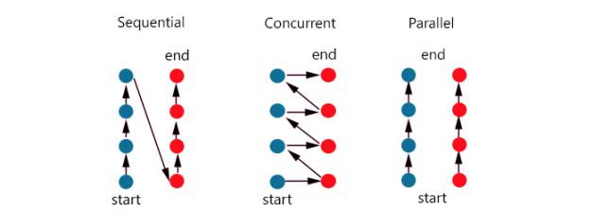
Concurrency vs. Parallelism

Slide 8
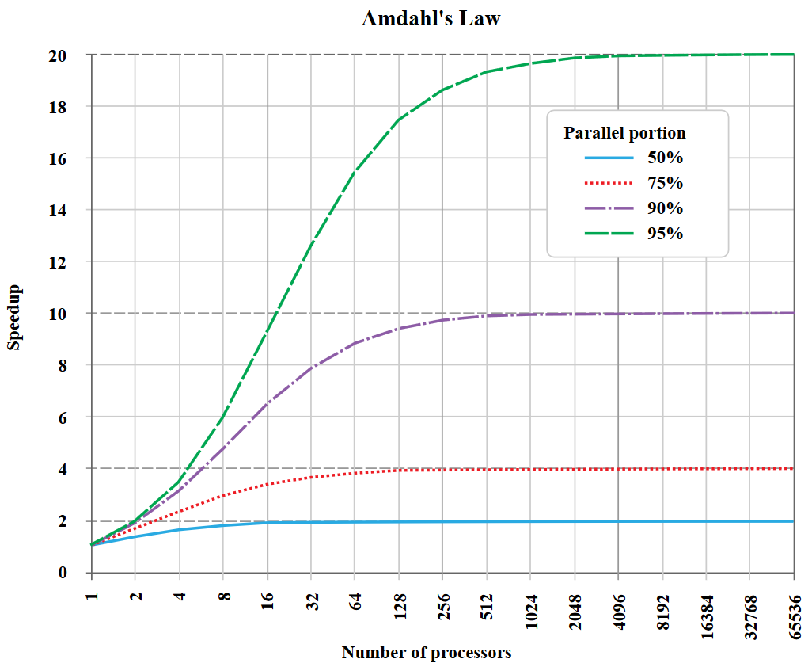
Concurrency vs. Parallelism
Amdahl's law

Slide 9
Concurrency Models
Shared memory communication
  Shared memory
  Usually threads
  Locking mechanism
Message passing communication (Actor Model)
  Exchange messages
  Independent actors
  No shared context

Slide 10
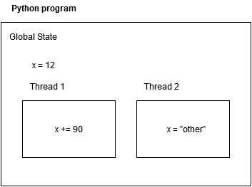
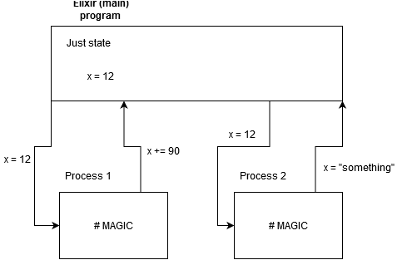

Slide 11
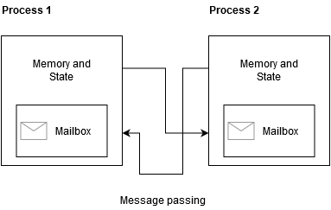
Erlang/Elixir Processes
VERY lightweight
Fast to create
Fast to terminate
  "Let it crash!"

Slide 12
SHOW TIME!
We will:
See PIDs: process identifiers
Spawn a new process
Watch the process die
Communicate with the process
  Send messages
  Receive message
Simulate React's Store/State

Slide 13
"Let it crash"
Most exceptions don't make sense (think "ConnectException")
Program the happy path > Defensive programming

Slide 14
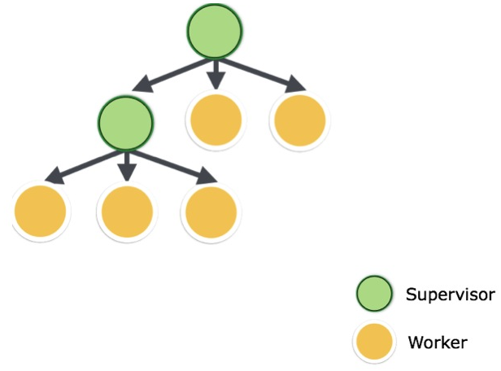
"Let it crash"
Worker
GenServer
Supervisor
Supervisor Tree

Slide 15
Hot Code Reloading
Allows for hasle-free, quick reload of modules

